Slide 2
I210 – Introduction to Programming with Python
Lecture 1
Fill out this survey: https://goo.gl/forms/MFVO29uudIYvM0VZ2

Slide 3
Why learn to program?
Programming lets us control computers
Making them do whatever we want, even if it’s something no one has ever done before
Learning to program will help you:
Create online tools, software, apps, games, etc.
Analyze data, optimize business strategies, etc.
Understand how computers work, and their capabilities and limitations
Be successful! Have fun! Get a job!

Slide 4
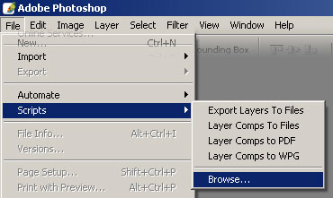
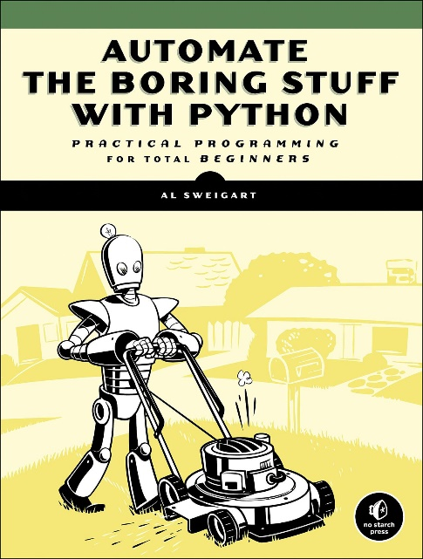
But I Don’t Want to Be a Programmer!
Even non-programmers benefit!
Common tools in design often have programming-like scripting elements for better control
Automating large and repetitive tasks is a huge time-saver
Your job may involve supervising or cooperating with colleagues who program.
Wouldn’t you like to be able to meaningfully discuss technology?

Slide 5
Programming involves…
Breaking down a problem into concrete steps that a computer can perform
Writing these steps in a language the computer can understand
Resolving any issues caused by your solution
We’ll learn how to do this process in I210
Key to learning: lots of practice! We’ll have in-class activities, labs, group projects, assignments….

Slide 6

Learning Languages
Treat learning to program like learning a foreign language…
You have to practice using it as much as possible!

Slide 7
Caveat Emptor
Many students find this class challenging
(We expect you to have no prior background)
Most important key to success: be proactive
Actively participate in class, labs, assignments
Get help when you don’t understand
Take advantage of all course resources!
Textbook, lectures, office hours, groups …
4 instructors, 45 AI/UIs – we want to help!

Slide 8
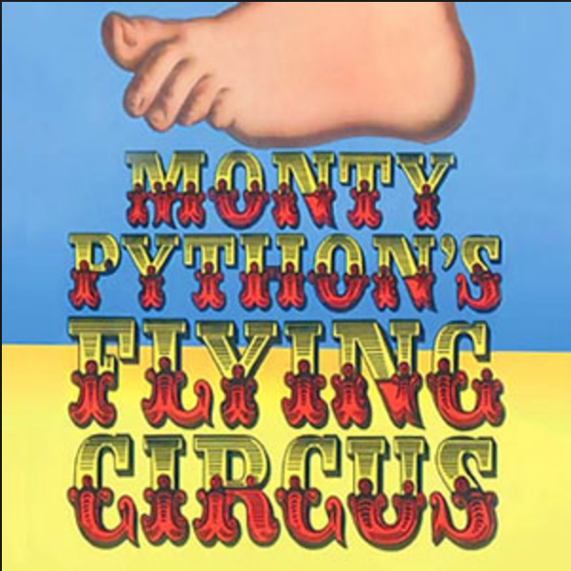
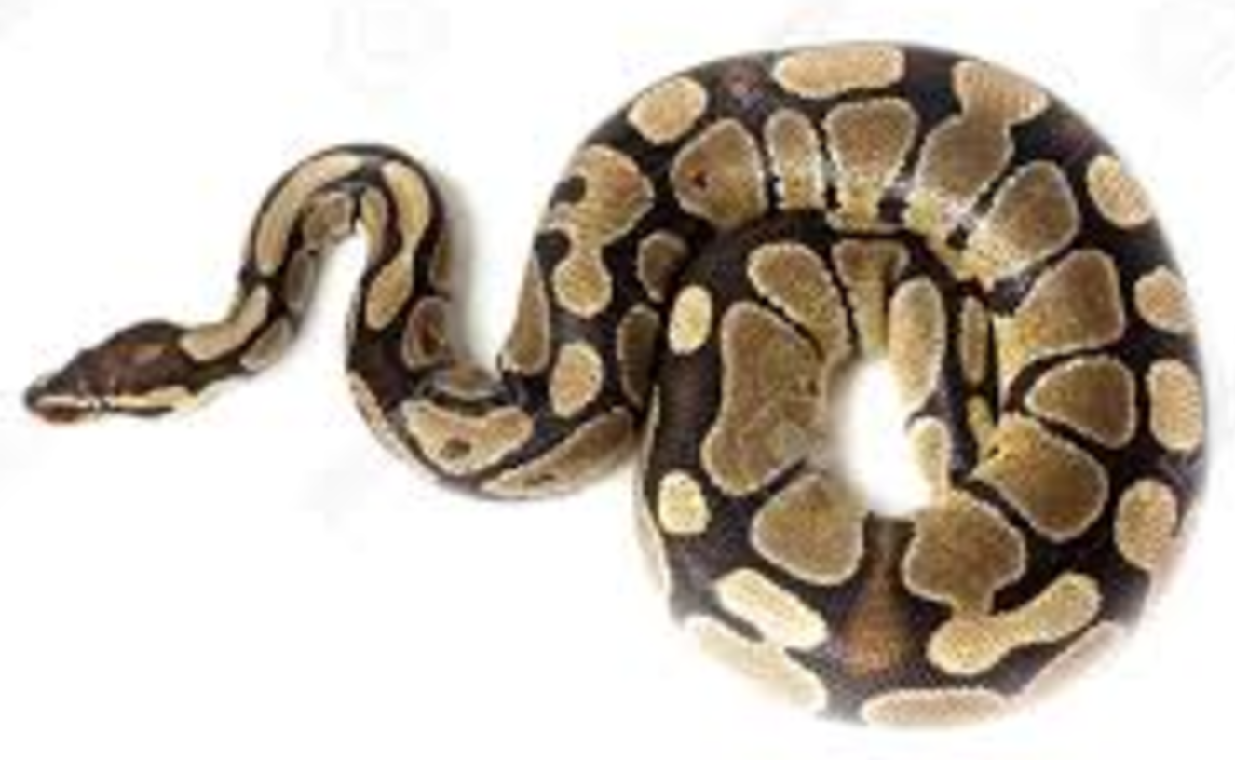
Introducing Python
Developed by Guido van Rossum (BDFL)
First released in 1991
Named after?

Slide 9
Why Python?
Runs everywhere – Platform independent!
PC, Mac, Linux, UNIX, smart devices
Only requirement is that python is installed
Easy to use, powerful!
Free and open-source!

Slide 10
Python Is Easy to Use
High-level language
"Programming at the speed of thought“
Python programs are often shorter and more easily legible than those in other languages

Slide 11
Python Is Easy to Use (continued)
Python Program
print("Game Over!")
C-style Program
#include <iostream>
int main()
{
std::cout << "Game Over!" << std::endl;
return 0;
}

Slide 12
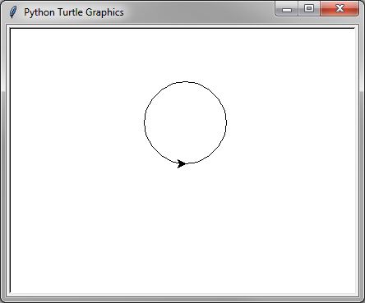
Python Is Easy to Use (continued)
Python Program
import turtle
myTurtle = turtle.Turtle()
myTurtle.circle(50)
turtle.getscreen()._root.mainloop()
Java Program
import java.awt.Graphics;
import java.applet.Applet;
public class ThreeStyles extends Applet
{
public void paint (Graphics g)
{
g.drawRoundRect(40, 50, 90, 90, 200, 200);
g.fillRoundRect(40, 160, 90, 90, 200, 200);
g.drawOval(150, 50, 90, 90);
g.fillOval(150, 160, 90, 90);
g.drawArc(270, 50, 90, 90, 0, 360);
g.fillArc(270, 160, 90, 90, 0, 360);
}
}
Both of these examples draw a simple circle…

Slide 13

So is Python the BEST Language?
Programming languages are tools.
Is there a best tool for ANY job?
No such thing as the “best language”
Python is (comparatively) easy to learn, is a very good tool for many problems, and best of all, the concepts you learn in this class will apply to almost any other programming language!

Slide 14
Computer program
Program (noun)
A sequence of instructions that are executed in order to accomplish a desired task.
Your job is often figuring out how to break complex task down into a series of explicit instructions.
An important step towards a program is an…

Slide 15
Algorithm
Algorithm (noun)
A finite set of precise instructions for performing a computation or solving a problem.
Example
How to add a list of numbers:
Start a total at 0.
Are there more numbers?
If so, add the next one to the total and return to Step 2.
If not, stop. The total is your answer.
This is why we covered algorithms in I201!

Slide 16
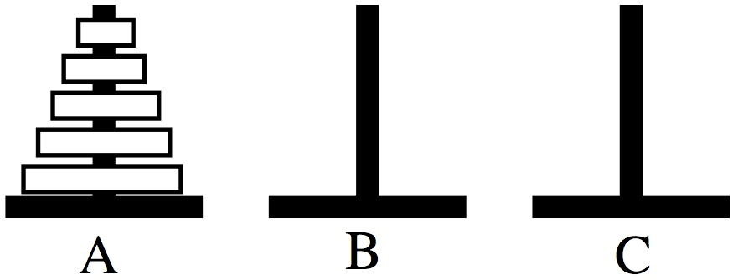
Group Work
Red
Orange
Yellow
Each group gets a set of props.
This round use the Red, Orange, and Yellow.
Stack them like the picture!

Slide 17
Group Work
Red
Orange
Yellow
Move the disks so they end up on peg C in the same order, with the following rules:
Only one disk may be moved at a time.
No disk may be placed on top of a smaller disk.
Only the top disk on a peg may be moved, and it becomes the new top disk on its destination peg
You want to end up with a written solution – an algorithm! How many moves did it take?

Slide 18

Start
Red
Red
Orange
Orange
Green
Yellow
Yellow

Slide 19
Red
Orange
Orange
Green
Red
Yellow
Yellow

Slide 20
Red
Orange
Green
Red
Yellow
Orange
Yellow

Slide 21
Red
Orange
Red
Green
Yellow
Orange
Yellow

Slide 22
Red
Orange
Red
Green
Orange
Yellow
Yellow

Slide 23
Red
Orange
Red
Green
Orange
Yellow
Yellow

Slide 24
Red
Orange
Orange
Red
Green
Yellow
Yellow

Slide 25
Done!
Red
Red
Orange
Orange
Green
Yellow
Yellow

Slide 26
Group Work: Peg Puzzle 2
Red
Orange
Yellow
Green
Move the disks so they end up on peg C in the same order, with the following rules:
Only one disk may be moved at a time.
No disk may be placed on top of a smaller disk.
Only the top disk on a peg may be moved, and it becomes the new top disk on its destination peg
Is there some way your solution for 3 disks could help you solve this problem with 4 disks?

Slide 27
Start
Red
Red
Orange
Orange
Yellow
Yellow
Green
Green

Slide 28
Red
Orange
Orange
Yellow
Yellow
Green
Red
Green

Slide 29
Red
Orange
Yellow
Yellow
Green
Red
Orange
Green

Slide 30
Red
Orange
Yellow
Red
Yellow
Green
Orange
Green

Slide 31
Red
Orange
Yellow
Red
Green
Yellow
Orange
Green

Slide 32
Red
Orange
Red
Yellow
Green
Yellow
Orange
Green

Slide 33
Red
Orange
Red
Orange
Yellow
Green
Yellow
Green

Slide 34
Red
Orange
Red
Yellow
Orange
Green
Yellow
Green

Slide 35
Red
Orange
Red
Yellow
Orange
Green
Yellow
Green

Slide 36
Red
Orange
Yellow
Orange
Red
Green
Yellow
Green

Slide 37
Red
Orange
Yellow
Red
Orange
Yellow
Green
Green

Slide 38
Red
Orange
Red
Yellow
Orange
Yellow
Green
Green

Slide 39
Red
Orange
Red
Yellow
Yellow
Orange
Green
Green

Slide 40
Red
Orange
Yellow
Yellow
Orange
Red
Green
Green

Slide 41
Red
Orange
Orange
Yellow
Yellow
Green
Red
Green

Slide 42
Done!
Red
Red
Orange
Orange
Yellow
Yellow
Green
Green

Slide 43
Peg Puzzle Solution
R O R Y R O R G R O R Y R O R
Solution for 2 disks
Solution for 3 disks
Solution for 4 disks

Slide 44
Group Work: Peg Puzzle
How many moves?
Minimum is 2⁴ – 1 = 15
However, your algorithm can have many fewer steps in it!

Slide 45
Group Work: Peg Puzzle
Solution 1:
Make the legal move between pegs A and B
Make the legal move between pegs A and C
Make the legal move between pegs B and C
If not done, return to step 1.
Or…

Slide 46
Group Work: Peg Puzzle
Solution 2:
Move the smallest piece to the right, wrapping around if needed.
Make the only legal move that doesn’t involve the smallest piece.
If not done, return to step 1

Slide 47
Interpreted Language
Python is an interpreted language.
A python program (.py file) is just a text file.
Interpreted
Read and executed directly – no compilation stage!
Examples: Python, Perl, Ruby, Lisp
Compiled
Compiled languages are transformed into an executable form before running.
Examples: C (and C++), Java

Slide 48
Introducing IDLE
Integrated DeveLopment Environment (IDLE) = an IDE!
IDLE ships with most Python versions
Interactive mode: You tell Python what to do, and it will do it immediately
We’ll start out working in this mode for CH 1 and 2
Script mode: You write, edit, load, and save python programs (just like you write a document in a word processor).

Slide 49
Jargon
Statement
Single unit in programming language that performs some action
String: Sequence of characters
Expression: Something which has a value or that can be evaluated to a single value
Code: Sequence of programming statements

Slide 50
Jargon
Comment: Note in source code meant only for programmers; ignored by computer
Start comments with #
Use opening block of comments
Blank Lines
Also (generally) ignored by computer
Use for legibility; keep related code together
Python cares about whitespace!
New lines (hitting Return/Enter) and tabs

Slide 51
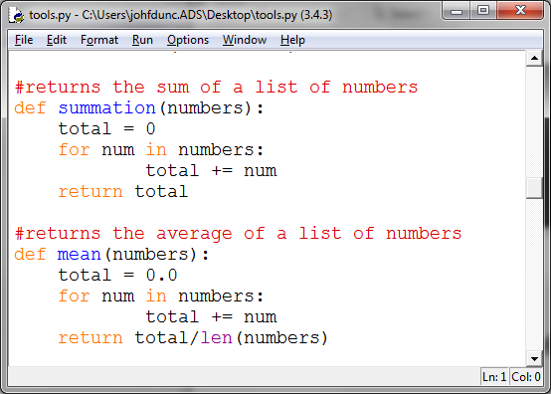
Jargon
Syntax highlighting:
Displaying programming code in different colors or fonts, according to the category of each item
Bug: Error in programming code

Slide 52
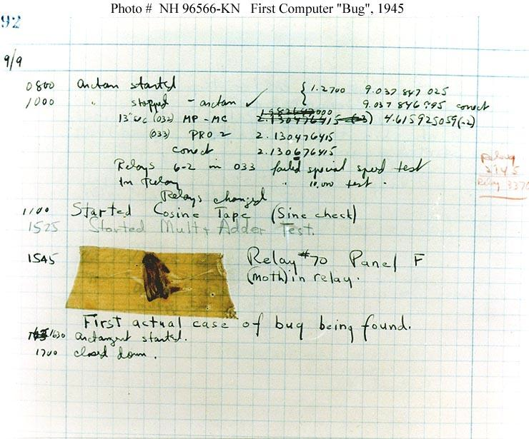
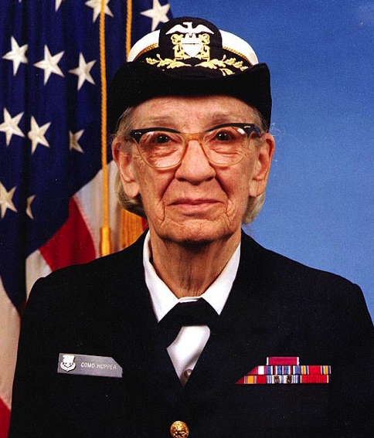
Bugs! You will get lots of them!
Admiral Grace Hopper
Even expert programmers get bugs all the time!

Slide 53
Problems
Syntax errors
The computer doesn’t understand what I wrote, because I made a typo.
English: “I hope you all hav a good day!”
Semantic errors
What I wrote doesn’t make sense in that order.
English: “Hope day good all you have!”
You are much smarter than the computer!

Slide 54
I210 – Introduction to Programming with Python
Lecture 2

Slide 55
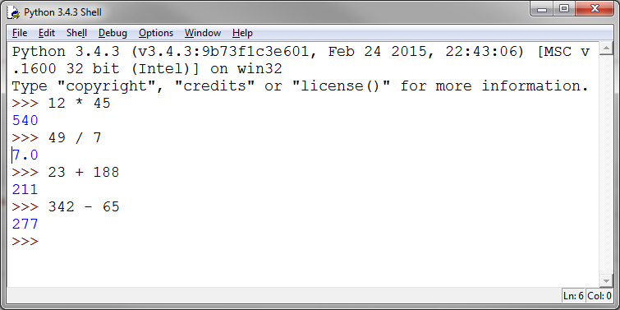
IDLE: Interactive Mode
IDLE’s initial window Make sure you have 3.X
You can type in an expression and get an immediate result (great for testing!):

Slide 56
Working with Numbers
Numeric types in Python
Integers: Numbers without a decimal part
1, 0, 27, -100
Floats (Floating-Point Numbers): Numbers with a decimal part (even if it’s .0)
2.376, -99.1, 1.0

Slide 57
Mathematical Operators
Operator | Description | Example | Evaluates To
+ | Addition | 7 + 3 | 10
- | Subtraction | 7 – 3 | 4
* | Multiplication | 7 * 3 | 21
** | Exponentiation | 7 ** 3 | 343
/ | Division | 7 / 3 | 2.33333333…
// | Integer by Integer Division (rounds down) | 7 // 3 | 2
% | Modulus (remainder under integer division) | 7 % 3 | 1

Slide 58
Modulus
Modulus gives the remainder under division
10 mod 3 → 1
means "what is the integer remainder when 10 is divided by 3?”
10 mod 2 → 0 because 2 evenly divides 10.
In Python, we use % for mod. 10 % 2 → 0

Slide 59
Functions
Function: A named collection of programming code that can receive values, do some work, and return values
A function is like a delivery restaurant:
Make a call : I’d like to order a curry
Provide information: I like chicken, spiciness 2
Get something back: your food

Slide 60
Functions
Values passed into a function are called arguments.
Values sent back by a function are called return values.
>>> abs(-10)
10
abs() is a function that takes a number as an argument, and returns the absolute value of that number.

Slide 61
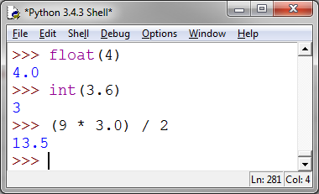
float() and int() functions
To convert an integer into a float, we can use the float() function OR multiply/divide by a decimal number.
If we use the int() function on a float, it will chop off the decimal part!
A calculation that involves a float will also return a float.

Slide 62
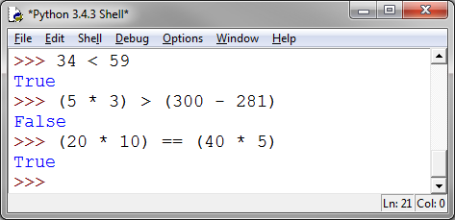
Boolean Values
Boolean values In addition to a numeric value, an expression can resolve to either True or False.
We have a number of operators that express these relationships:

Slide 63
Boolean Comparison Operators
Operator | Name | Example | Truth Value
== | Equals | 5 == 6 | False
!= | Not Equal | 5 != 6 | True
> | Greater Than | 5 > 6 | False
>= | Greater Than or Equal | 5 >= 6 | False
< | Less Than | 5 < 6 | True
<= | Less Than or Equal | 5 <= 6 | True
* Be sure to note that we use == for equality. = has a different meaning.

Slide 64
Variables
Variables store information in your program
A variable is a placeholder for values
You can assign different values to variables, and you change the value of a variable over time
Example price
26

Slide 65
Variables
Variables store information in your program
A variable is a placeholder for values
You can assign different values to variables, and you change the value of a variable over time
Example price
40

Slide 66
Variables
Variable names are unique and case-sensitive
name and nAme are NOT the same!!
A variable contains data that has a type (e.g. integer, string)
Python does not require you to declare that type when declaring a variable – it figures it out.
You can even change the value of a variable to a different type of data!

Slide 67
Variable Definitions
A variable is created using a declaration:
my_number = 3
The value 3 here is the initial value of the variable.
A variable is assigned further values using = (assignment operator)
my_number = 6 * 5

Slide 68
Naming Variables
Legal variable names:
Contain only numbers, letters, and underscores
But don’t start with a number
Starting with _ means something special (for now, don’t)
Can’t use certain words (reserved or keywords)
Keywords in Python 3.4:
False None True and as
assert break class continue def
del elif else except finally
for from global if import
in is lambda nonlocal not
or pass raise return try
while with yield

Slide 69
Naming Variables
Good naming:
Is descriptive! (name vs n)
Is consistent! (newPrice or new_price, pick one)
Observes conventions (start with lowercase letter)
Isn’t too long (try for no more than 15 characters)
Remember, case matters!!!
my_name and my_nAme ARE NOT the same!!

Slide 70
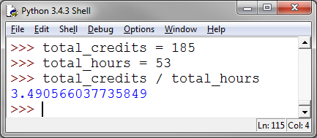
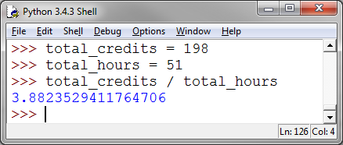
Example - Calculating GPA
GPA is your total number of credits divided by your total number of credit hours.
We can calculate this with a few variables and the division operator:

Slide 71
Problem
What is being done here?
t = n * 60

Slide 72
Goal
One of our most important goals: Self-Documenting Code!
This means your code is so legible, you can use only minimal comments.
Choosing good variable names is a key step!
time_in_min = num_hours * 60
(The names make this step clear.)

Slide 73
Average Age (Group Work)
Use the Interactive Mode in IDLE to prove or disprove this statement:
“The average age of the people in our group is at least 20.”
HINT: How to compute an average:
Compute the total, divide by the number of items
Use a variable for total sum of the ages.
Use a Boolean condition to show whether the statement is True or False for your group.

Slide 74
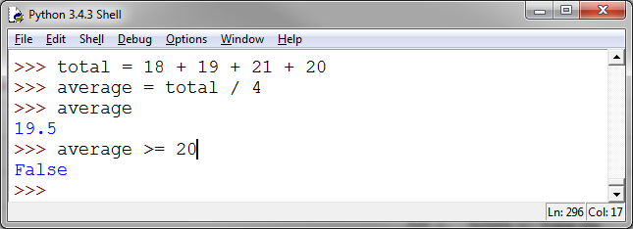
Average Age (Answer)
Let’s assume the group includes 4 people and their ages are 18, 19, 20, 21
This program shows the statement is False for this group!

Slide 75
Compound Boolean Conditions
We'll often want to write more complicated Boolean Conditions.
E.g. For a computer security system:
Display an error message if a user does NOT enter their username
Allow user to log in if username AND password are correct
Notify staff if a break-in is detected OR if an incorrect password is entered 3 times

Slide 76
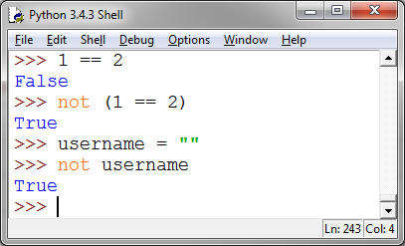
NOT
not is a logical operator that reverses the value of any Boolean Condition
TAKE NOTE:
The values 0, "", and None are also considered to be False.

Slide 77
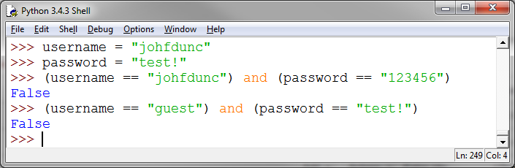
AND
and is a logical operator that connects two Boolean Conditions. It’s True if they are BOTH true, and False otherwise.
If I have the wrong username or the wrong password…

Slide 78
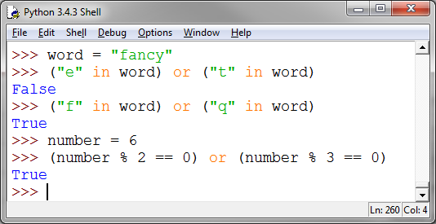
OR
or is a logical operator that connects two Boolean Conditions. It’s true if either of them is true OR if they both are!
Question: Is this the way we use OR in English?

Slide 79
XOR
xor, or exclusive or, is a common CS operator which behaves like the ‘or’ we know in English:
“It will rain tomorrow or it will not” – Can both be true?
True xor True = False
False xor False = False
True xor False = True
Python doesn’t implement this as xor, but you can do it like this:
boolean_condition1 != boolean_condition2
p | q | p ∨ q | p ⊕ q
F | F | F | F
F | T | T | T
T | F | T | T
T | T | T | F
From I201:

Slide 80
Precedence
variableA OR variableB AND variableC
If this ever comes up, this is the order of precedence, from most to least:
Not
And
Or
Lesson – Use parenthesis!!
time_out or (correct_id and correct_pw)

Slide 81
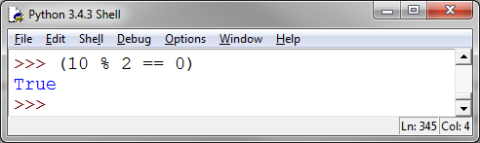
Find a Number (Group Work)
Use the Interactive Mode of IDLE to find a number that is evenly divisible by 6 and 15, but not evenly divisible by 9.
Use a compound Boolean condition to test this.
HINT: We use the modulus operator to test for a number being evenly divisible by another number.

Slide 82
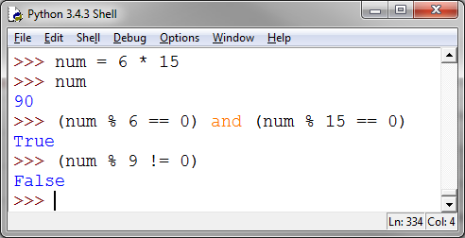
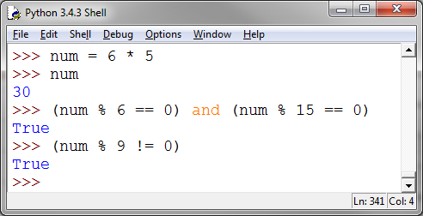
Find a Number (Answer)
90 ( 6 * 15) doesn’t pass the last test:
But 30 does!

Slide 83
Questions?

Slide 84
I210 – Introduction to Programming with Python
Lecture 3

Slide 85
Today
strings (and concatenation) – New data type
in operator
len function
indexing strings
lists (changing, deleting, min/max/sum, appending, removing, sorting)
methods versus functions

Slide 86
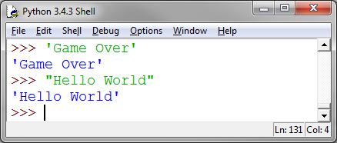
Strings: Using Quotes
Strings (text values) in Python use quotes.
Either single quotes ' or double quotes " work!
Start and end with the same quotes:

Slide 87
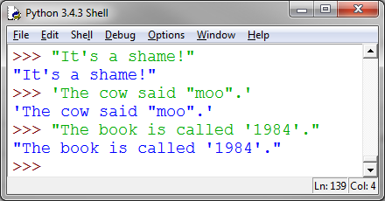
Strings: Using Quotes
Why choose one quote over the other?
If your string includes one type of quote (or apostrophe), use the other one:
IDLE defaults to single quotes, but I prefer double quotes

Slide 88
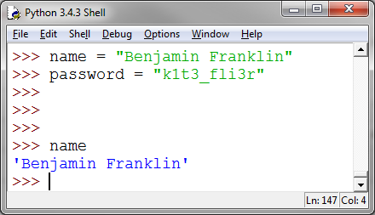
Strings
Strings can be stored in variables also:

Slide 89
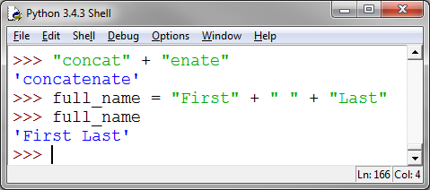
String Concatenating
Concatenation: Joining together of two pieces to form a larger whole
In Python, the string concatenation operator is also +

Slide 90
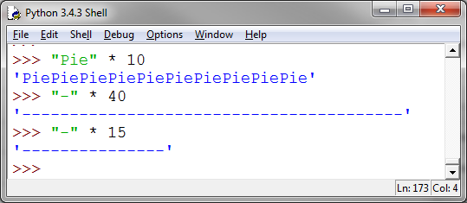
Repeating Strings
The * operator creates a new string by concatenating a string a specified number of times:
This will be useful later!

Slide 91
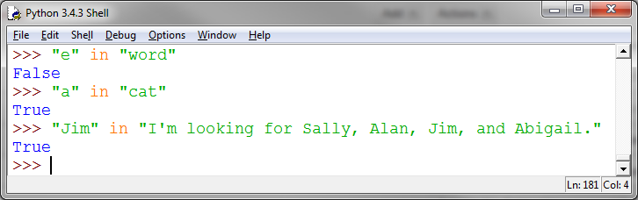
in operator
The in operator allows us to see if something is found in a collection of things.
We can test for a string being a substring of another string:

Slide 92
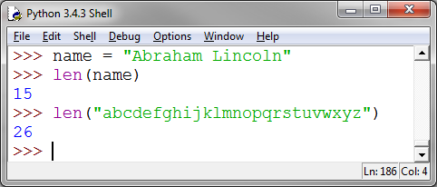
len function
The len function (short for length) counts the number of pieces in a collection.
A string is a collection of characters, so it tells us how many characters (including spaces) are in a string:

Slide 93
Indexing strings
word = "learn”
Each letter in a string has a numeric position called an index.
This numbering starts at 0, not 1!!
L | E | A | R | N
0 | 1 | 2 | 3 | 4

Slide 94
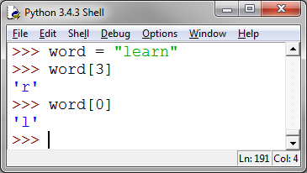
Indexing strings
word = "learn"
We can refer to these by using indexing:
L | E | A | R | N
0 | 1 | 2 | 3 | 4
This is also called indexing into something.

Slide 95
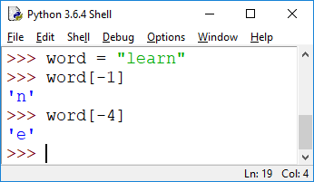
Negative Indexing
L | E | A | R | N
-5 | -4 | -3 | -2 | -1
Sometimes, we care more about the end of a string.
We can use negative indexing to quickly refer to the characters in a string, starting at the end:

Slide 96
Indexing (Group Work)
message = "I like Python."
What are the values of the following?
Discuss this with your group FIRST, then see if you’re right by using IDLE.
message[0]
message[-10]
message[13]
message[-13]
message[0] != message[-5]
(message[3] == "i") and (message[13] != ". ")

Slide 97
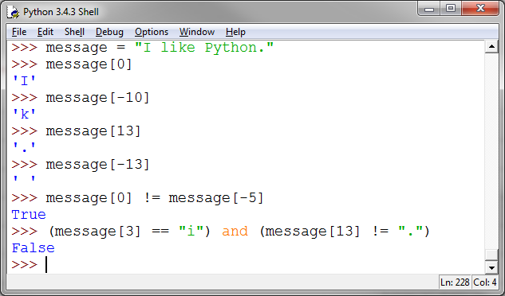
Indexing (Answer)
0 | 1 | 2 | 3 | 4 | 5 | 6 | 7 | 8 | 9 | 10 | 11 | 12 | 13
I |  | l | i | k | e |  | P | y | t | h | o | n | .
-14 | -13 | -12 | -11 | -10 | -9 | -8 | -7 | -6 | -5 | -4 | -3 | -2 | -1

Slide 98
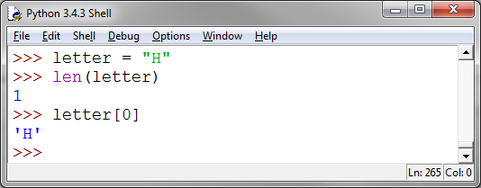
len()
>>> len( "I like Python." )
14
Remember, len counts 1 character as length 1, but the index to that position is 0.

Slide 99
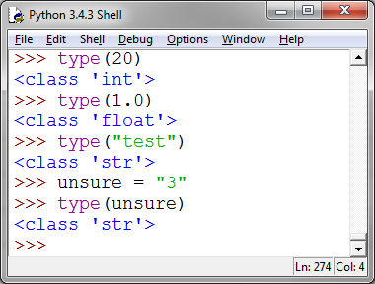
The type function
If you’re ever unsure what kind of data you have, you can use the type function:

Slide 100
2 More Types of Errors
Logical Errors
All the syntax is correct
All the semantics are correct
Program does not perform correctly
Runtime Error
The program begins to execute, then crashes
These will happen more when we learn to give direct input to our programs

Slide 101
Index Puzzle (Group Work)
If we can only use string indexing and concatenation, how could we make the string "python" from these variables?
vow = "aeiou"
con = "bcdfghjklmnpqrstvwxyz"
Use IDLE’s interactive mode to demonstrate your answer.

Slide 102
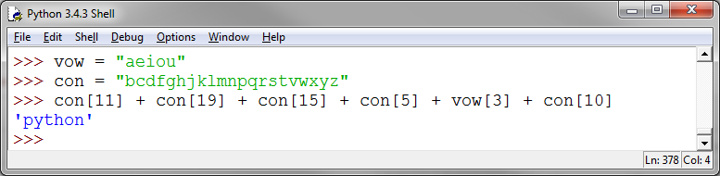
Index Puzzle (Solution 1)

Slide 103
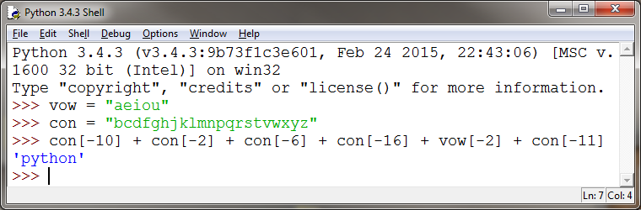
Index Puzzle (Solution 2)

Slide 104
Understanding Sequences
Sequence: An ordered list of elements
Element: A single item in a sequence
Iterate: To move through a sequence, in order
Example: The 10 best movies this year
This a sequence because it has an order
The elements are the movies
We could iterate over it 1 to 10, or 10 to 1

Slide 105
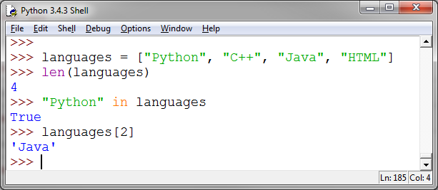
Lists - Creating
Lists in Python are a data type for storing sequences. Lists use square brackets: [ ]
In other languages, they might be called vectors.
Notice how len(), the in operator, and indexing work:

Slide 106
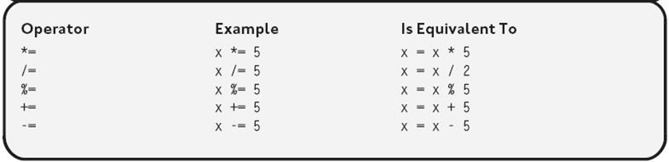
Augmented Assignment Operators
Often, we assign a value to a variable based on its original value, or concatenate a new piece on.
Augmented assignment operators:
Original: score = score + 1
Augmented: score += 1

Slide 107
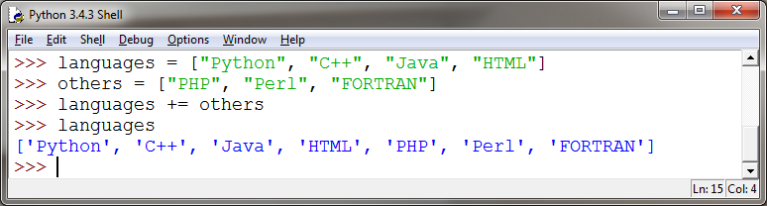
Lists – Concatenating (adding)
Lists add like strings and tuples:

Slide 108
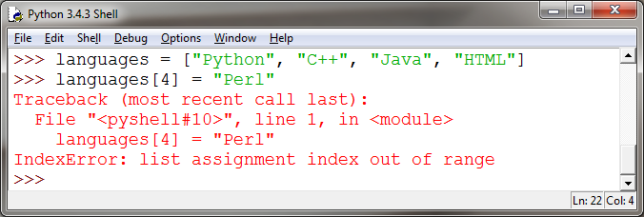
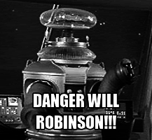
Lists – Changing Elements
Make sure you don’t try to change elements that don’t exist!!

Slide 109
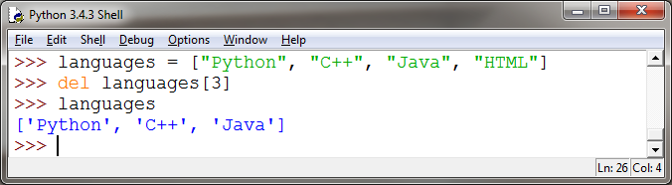
Lists – Deleting Elements
We can erase a portion of the list by using the keyword del:
del

Slide 110
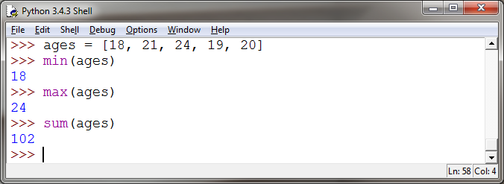
Lists – min, max, sum
Python has three very useful functions for working with numeric lists:
min, max, sum

Slide 111
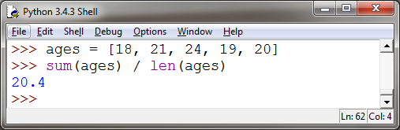
Lists – min, max, sum
Notice how short a program we can write to solve the problem of calculating the average age of a group:
Good code makes use of existing functionality where appropriate.

Slide 112
Functions and Methods
The words method and function are often used interchangeably by programmers.
Let’s use method to refer to a specific type of function in Python – one that’s tied to an object.
Objects are things like strings, or files, or lists

Slide 113
Methods vs Functions
We call a method like this:
object_name.method_name()
Functions, like float() are called on their own:
>>> float(3)
3.0
Notice the dot!
No dot!

Slide 114
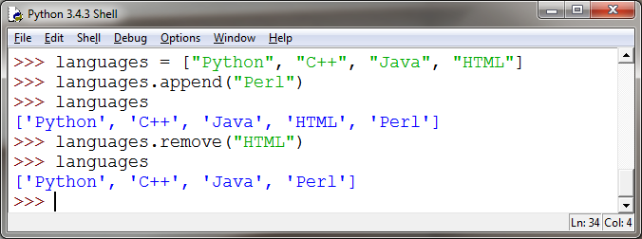
Lists – Appending and Removing
The .append() method is the preferred way to add things to a list! It will add the new element to the end.
The .remove() method removes an element from the list based on its value.

Slide 115
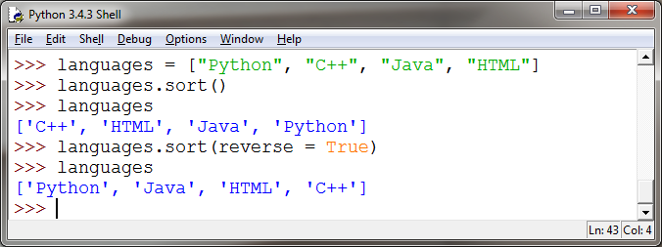
Lists - Sorting
We can .sort() a list in ascending or descending order:
Be careful! These methods change the original list!

Slide 116
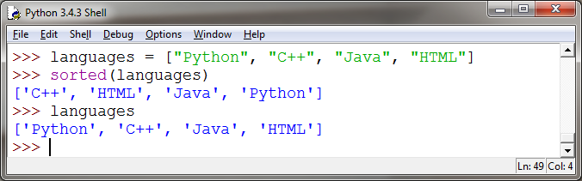
Lists - Sorting
If you don’t want to change the original list, use sorted( list_name ) , which returns a sorted copy, but doesn’t change the original.

Slide 117
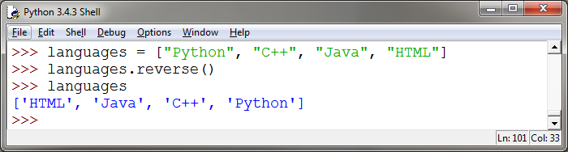
Lists - Reverse
Another method that changes the original list is .reverse() :

Slide 118
List of Names (Group Work)
Create a list of the first names of everyone in your group and assign this list to a variable.
Append the name “Emily” to your list.
Sort the names alphabetically.
Display the names after they’ve been sorted.
Use a function to show how many names are in your list.
Write a Boolean test to see if “Ben” is one of the names in your group.

Slide 119
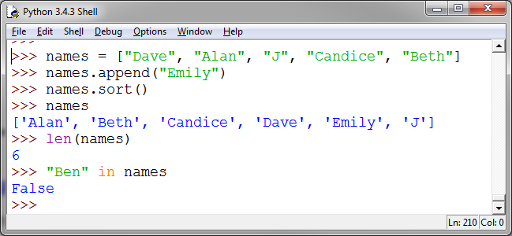
List of Names (Solution)

Slide 120
Questions?

Slide 121
I210 – Introduction to Programming with Python
Lecture 4

Slide 122
Today
More List Methods
Tuples
Modules
Script Mode
The print function
The input function
.join() .sort() copy() dir() help() input()

Slide 123
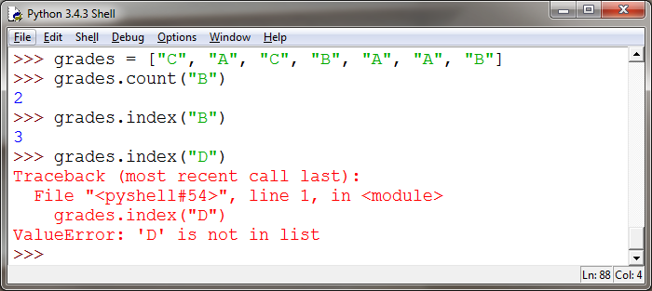
Lists – Count and Index
We can count occurrences of an element or find an index based on value. This returns the index of the FIRST match only.
Caution! You’ll get an error if your target isn’t in the list!

Slide 124
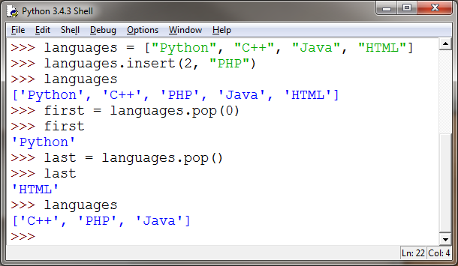
Lists – Inserting and Popping
We can insert elements at an index, and we can remove an element to use it.
The default for .pop() is the last position if you don’t pass it a number.

Slide 125


Immutable vs Mutable Sequences
Mutable: Changeable once set at every level
Immutable: Unchangeable once set
Unlike lists, strings are immutable sequences - they can’t be altered at the element level.

Slide 126

Tuples
Tuples are essentially immutable lists.
(Tuples are also known as arrays.)
We create tuples with parenthesis: ( )

Slide 127

Tuples
In terms of indexing, len, and the in operator, tuples behave exactly like lists:

Slide 128

Tuples
But tuples are immutable, so we can’t dynamically change their elements:

Slide 129

Tuples
Tuples don’t support a lot of the “fancier” options we have with lists, like .append()

Slide 130

Tuples
… but we can add elements to tuples with concatenation!
Notice: if you don’t put the comma there, Python doesn’t know it’s a tuple, and you get an error!

Slide 131

The tuple() and list() Functions
There are tuple() and list() data conversion functions that take a string, but they create tuples and list of characters!

Slide 132

.join
The .join() method can reassemble a list or tuple of strings:

Slide 133

Tuples vs. Lists – Why have both?
Python can run code on tuples faster than on lists, because tuples have fewer features!
Tuples are used for data that doesn’t change much, like a sequence that stores the states in the USA.
Classic trade-off in Programming: convenience vs. speed
Assuming that elements can't change makes tuples much faster, but programming harder
So Python gives you two options:
tuples (fast but limited)
lists (slow but flexible)

Slide 134
Sorted Names (Group Work)
Create a string variable that contains all the last (family) names of your group members, separated by spaces.
Convert this value to a list of characters.
Sort the list of characters.
Use .join() to re-assemble the characters into a string.
In what order are punctuation (like spaces), capital letters, and lowercase letters placed?

Slide 135

Sorted Names (Solution 1 & 2)
Notice how much shorter a program can be if we make good use of all of our tools!

Slide 136


Shared References
Take 1 minute to look at these two examples with your group. Discuss what’s different.

Slide 137

Shared References
Simple values like ints, floats, and strings are copied by value. This means that when we assign one to a variable, the value is copied over.
score
10
new_score
10

Slide 138

Shared References
Complex values like lists are copied by reference. That means that when we assign one to a variable, it makes a reference to the original.
So anything we do to one is done to the other!
ages
19, 22, 20, 21
new_ages

Slide 139

The .copy() Method
We can create an actual copy with .copy() :

Slide 140
Modules
Module: a file that contains a collection of programming code.
Modules can be used by importing them, at which point the code becomes part of the current program.
Not all of Python is loaded by default! Importing allows us to use more of the language.

Slide 141

Using Modules
Modules contain groups of related functions:
math contains a lot of useful mathematical code
Modules can also contain classes or constants
math.pi
Normally when we import a module we then have to say modulename.methodname()

Slide 142

What’s in a Module?
The built-in function dir() is used to find out what a module defines. It returns a sorted list of strings:
This can be helpful if you can’t remember the name of a function in a module.

Slide 143

What’s in a Module?
Need more? Try the help() function. This gives a LOT of information.

Slide 144

Volume (Example)
Here’s a short program that calculates the volume of a rectangular solid that’s 3 units wide, 4 units long, and 6 units high:

Slide 145
Surface Area 1 (Group Work)
Write a similar program that calculates the surface area of a cylinder. Remember, you can use math.pi if you’ve imported the math module. Look the formula up on Google!
You can test your program with a cylinder of radius 5 and height 8.
The surface area should be 408.4070449666731

Slide 146

Surface Area 1 (Group Work)
Here’s my solution:

Slide 147

Script Mode
We open Script Mode in IDLE by choosing “New File”:
This is where we’ll write our programs from now on. We can still use Interactive Mode to test things!

Slide 148
Script Mode and HW
All Homeworks after HW1 will be turned in using Script mode.
Save your programs as .py files and turn these in.
You should follow this naming convention:
your username_homeworknumber_problemnumber.py
So I might turn in johfdunc_HW2_319.py

Slide 149





The print() Function
To see how Script Mode works, let’s introduce a way to get output from a program.
The print() function takes a string and outputs it to the console. Here’s a traditional first program:

Slide 150


The input() Function
We also need a way to ask the user to input information:
The input() function prompts the user for keyboard input, and returns a string.

Slide 151

The input() Function
We can use information the user gives us in our programs!

Slide 152


Using Data From the User
What went wrong here?

Slide 153


Using Data From the User
We probably need to convert the data from the user to an integer.
But that causes this problem:

Slide 154


Using Data From the User
So we have to convert it BACK when we print!
Now it works!

Slide 155

Surface Area 2 (Group Work)
Re-write your surface area program in Script Mode:
Prompt the user for the values to be stored in radius and height.
You’ll still need to import the math module, and you will need to convert the data from a string to an integer and back!
The screenshot below shows 2 sample runs of the program.

Slide 156

Surface Area 2 (Solution 1)

Slide 157
Comments
Are a reminder, any line that starts with a # will be ignored by Python. IDLE will highlight it in red.
Comments are very important tools for organizing code and communicating with other people who may need to read it!
Comments are a factor in grading.
It’s not 1 comment per 1 line. Use comments to organize sections of the code.

Slide 158

Surface Area 2 (Solution with Comments)

Slide 159
Questions?

Slide 160
I210 – Introduction to Programming with Python
Lecture 5

Slide 161

Today
Comments
The eval() function
Making decisions:
If statements
Else clauses

Slide 162
Script Mode and HW
All Homeworks after HW1 will be turned in using Script mode.
Save your programs as .py files and turn these in.
You should follow this naming convention:
your username_homeworknumber_problemnumber.py
So I might turn in johfdunc_HW2_319.py
You can also turn in 1 file as johfdunc_HW2.py

Slide 163

print() with commas
The print() function has a shortcut with commas.

Slide 164


Seconds Per Day (Version 2)
Here we compare the two ways to output with print().

Slide 165

Style Tip – Variable Use
Use variables when:
The same result is needed in more than one place.
Naming the information makes the code more legible.

Slide 166


The eval() function
Need to get something other than a string from the user? Try the eval() function! Python evaluates the expression.

Slide 167


A Runtime Error Waiting to Happen
eval() won’t save you from the user entering a zero value!

Slide 168

Always Watch Out for Zero Division!
How can we guard our programs (and houses) from the terror of division by 0?
Our programs need to be able to make decisions…

Slide 169


Temperatures (Group Work)
Ask the user for a number, then convert from C to F AND from F to C according to these formulas:
From C to F – Multiply by 9/5, then add 32
From F to C – Subtract 32, multiply by 5/9
Print both results out. Two examples shown below:

Slide 170

Temperatures (Solution)
What if we only want to print out the “right” conversion?
Again, our program needs to be able to make decisions.

Slide 171


Short Greeting Program

Slide 172

Branching
We ask for the user’s age…
Special greeting for our seniors (65+)?
If the user is 65 or older, output: “Don’t forget to ask about our senior discounts!”
We’ll use a Boolean Condition and an if statement.

Slide 173
If statement
if Boolean Condition:
#Whatever we want to happen if the condition is True
#Something else we want to happen
#Something that needs to happen all the time
Indent the lines of code that go under the if statement.
You can use TAB (recommended) or SPACE (2-4 spaces)

Slide 174


If statement

Slide 175
Branching – if and else
What if we want to do something if the Boolean Condition evaluates to False?
We can use an OPTIONAL statement, else.
if Boolean Condition:
#Whatever we want to happen if this condition is True
else: #NOTE – no Boolean Condition!
#This will happen if the else clause is False

Slide 176


Branching - if and else

Slide 177


ATM Program

Slide 178

Temperatures 2 (Group Work)
Change your temperature program to ask the user whether they want the conversion to C or to F. Only print out the correct conversion.
BONUS POINT: If the user doesn’t enter C or F, print a message.

Slide 179

Temperatures 2 (Solution 1)

Slide 180

Temperatures 2 (Solution w/ BONUS v1)
Putting a structure like an if-else inside of another if-else is called nesting.

Slide 181

Temperatures 2 (Solution w/ BONUS v2)
Using a tuple makes this Boolean Condition less complex!

Slide 182
Indentation and Code Blocks
Correct:
if password == "secret":
print("Access Granted")
else:
print("Access Denied")
Incorrect:
if password == "secret":
print("Access Granted")
else:
print("Access Denied")
Indenting (or using spaces) creates code blocks – units of code with a meaning!

Slide 183
Treating Values as Conditions
Any value can be interpreted as True or False (as a Boolean condition)!
Any empty (None) or zero value is False
So, 0, "", and None are False
Any other non-empty value is True
So for example, -10, 2.5, "banana" are True
if money:
money is treated as a Boolean condition
True when money is not 0, "", or None
False when money is 0, "", or None

Slide 184
Branching
What if we want to make multiple decisions?
“Ask a user to vote for Candidate A, B, or C, and display a different message for each, plus a message if they try to ‘write in’ someone else.”
We could do this with multiple if statements, but there’s a better way – the elif statement (short for ‘else if’). Like else, elif is an optional "addition" to an if statement.

Slide 185
If, elif, and else statements
if Boolean Condition:
#Whatever we want to happen if this condition is true
elif Other Boolean Condition:
#Whatever we want to happen if this condition is true
elif Third Boolean Condition:
#Whatever we want to happen if this condition is true
else:
#This will happen only if ALL conditions are false!
#Something that needs to happen all the time
Statements like these are sometimes called “if-then-else” statements in other programming languages )

Slide 186

Voting Program

Slide 187

If / elif / else structures
The first match means we stop!!!

Slide 188

Odd or Even (Group Work)
Ask the user for a number (they could enter a decimal), then say if it’s odd, even, or not a whole number.
Experiment with Interactive Mode to see how you can tell!

Slide 189

Odd or Even (Solution 1)

Slide 190

Odd or Even (Solution 2)

Slide 191
Questions?

Slide 192
I210 – Introduction to Programming with Python
Lecture 6

Slide 193

Today
Sequences
For Loops
The range() function

Slide 194

Quiz Advice
Your answers should follow our style advice!
Surround operators with spaces.
Don’t put spaces after function names!
If you don’t pay attention, you may lose points!

Slide 195
Quiz Advice
Does the question use checkboxes that allow more than one answer to be selected? If so, you may need to select more than one answer.
Does the questions use radio buttons that allow only one answer to be selected? Then most likely, only one answer is the BEST answer.
Be careful! If we legitimately made a mistake, email Erika at ebigalee@indiana.edu. Say WHAT question and WHAT answer need to be fixed.

Slide 196


Quiz 2 – Common Mistake
If you have a situation like this:
It’s better to use else: That way, if the first Boolean condition is True, we don’t have to check the second one.

Slide 197
Program Planning (Algorithms)
Algorithm: Set of clear, easy-to-follow instructions for solving a problem or accomplishing a task.
Start at the highest level – what does your program need to accomplish?
Then, break those goals into individual steps
The steps in your algorithm often become your comments!
We’ll show algorithms for our problems before the solutions.

Slide 198
Remember This?
Sequence: An ordered list of elements
Element: A single item in a sequence
Iterate: To move through a sequence, in order
So how do we iterate?
We’ll use a structure called a loop that can repeat code. First, we’ll learn for loops.

Slide 199
For loops and sequences
This is the simplest way to use a for loop to iterate over a sequence:
for var in sequence:
#code block goes here #and must be indented
The value of var starts out as the first element of the sequence, then becomes the next, etc.
Style Note: var is a variable you’re declaring as part of writing the loop, so follow our rules for variable naming!

Slide 200

For loops and sequences
A list is a sequence. So if we had a list like this:
names = ['Herb', 'Elizabeth', 'Lars', 'Lisa', 'Owen']
We could use a for loop like this:
for name in names:
print(name)
TIP: Sequence names are often plural. For loops often use a singular form of the word!

Slide 201


For loops, strings, in
A string is also a sequence.
When we loop over it, the elements are characters.
By default, if we print each element, it will be printed on its own line.

Slide 202


For loops, strings, in
Python allows us to manually specify the end character in a call to the print function.
By setting it to " " here, we cause all of the output to be printed on the same line.
This is called suppressing the newline.

Slide 203

Letter Counter (Group Work) *
Write a program that asks the user to give you a lowercase string, and a letter that might be in the string. USE A LOOP to tell them how many times that letter occurs. (We also know a method, but use a loop instead!)

Slide 204
Letter Counter (Algorithm)
Get a string from the user
Get a letter from the user
Start a count at 0
Walk through the string character by character
If the current character is the letter we’re looking for
Add 1 to our count
Output the result to the user

Slide 205

Letter Counter (Solution)

Slide 206

Letter Counter (With Method)

Slide 207


The range() function
The range() function gives us a sequence of integers (a list!). Here are three ways you can call it:

Slide 208


range() and len()
The range() function is often combined with the len() function to allow us to loop over the elements of a sequence.
TIP: print() by itself produces a blank line.

Slide 209

Single Letter Variables
Variables with single letter names (like i, j, or k) are, by tradition, only used when they represent index numbers in a loop.
This is confusing because an experienced reader expects i to be a number.

Slide 210


Index Numbers and For Loops
Combining index numbers and for loops allows us to change things in a list with a loop!

Slide 211


Index Numbers and For Loops
We can’t change strings the same way, however:
Remember, strings and tuples are immutable!

Slide 212


Index Numbers and For Loops
There are other ways to use the length of a string to make a new string!

Slide 213
The 2 types of for loop
1
for char in word: #do something to each letter
#where we don’t care about
#the index position
for i in range(len(sequence)):
#use an index number
#to accomplish something #single letter variable names
Use a for loop over a sequence if you just need to do something to each element, and it doesn’t require you to know where you are in the sequence.
Use a for loop with range and a numeric loop control variable if you need to know where you are in a sequence.
Single letter variable names here only!
2

Slide 214

Letter Counter v2 (Group Work) *
Change your program to also inform the user where (at what index position) the letter was found!

Slide 215
Letter Counter v2 (Algorithm)
Get the lowercase string from the user.
Get a letter from the user.
Start a count at 0
Walk through the string by index positions
If the current character is the letter we’re looking for
Print out a message about the position
Add one to (increment) the count
Output the final count

Slide 216

Letter Counter v2 (Solution 1)

Slide 217

Letter Counter v2 (Solution 2)

Slide 218

Disemvoweler (Group Work) *
Prompt the user for some text. Remove all the vowels from it, and print it back to the user. (Vowels are a,e,i,o,u)
Hints:
Create a separate variable for the shortened text
Use the in operator to test letters for “vowel-ness”
Just worry about lowercase for now! We’ll learn more soon….

Slide 219
Disemvoweler (Algorithm)
Get text from the user
Create a new blank string
Walk through the word one letter at a time
If the current letter is NOT found in "aeiou"
Add it to the new string
Output the new string

Slide 220

Disemvoweler (Solution)

Slide 221
Questions?

Slide 222
I210 – Introduction to Programming with Python
Lecture 7

Slide 223

Today
Functions
The return statement
Multiple return values

Slide 224
Functions
So far we've seen many built-in functions that let us do complicated operations easily:
print() int()
input() str()
len() float()
range() eval()
We can also create our own functions!

Slide 225
Why write your own functions?
Divide and conquer
Break a complicated problem into simpler problems
Encapsulated Testing – test only one piece at a time!
Avoid writing redundant code
Copying and pasting code is almost always a bad idea!
Write a re-usable tool: create a function for the job.
Legibility
90 lines of code or 3 functions of 20 - 40 lines?

Slide 226

A function is like a machine…
A machine is designed to do a specific task
Machines take time to build, but save it in long run
You can use a machine without having to understand exactly how it works inside
You just have to know how to interact with it!

Slide 227
A function is like a machine…
Process
Machines take input and produce output
A user only has to know what kind of input it needs, and what kind of output it produces
The machine's creator has to also design the process that goes on inside the machine
Input
Output

Slide 228


Function Metaphor
Elaine
Let’s say our machine engraves key chains.
The input will be a word or phrase.
The process describes how to take each piece of the input and engrave it onto the keychain.
The output will be the engraved keychain.
We don’t want to output the first half of the keychain, then the second half.

Slide 229
Function Components
Likewise, functions are defined by 3 components:
Arguments (input) Information the function needs to be able to do its job.
Function Body (process) The code inside the function that does the job.
Return Values (output) Information the function sends back.

Slide 230
Functions
To create a new function, we begin by writing a definition.
def function_name( argument1, argument2, etc… ):
#code for function goes here
#more code, etc
return return_value #sends this back!
Function parts: Arguments, Function Body, Return Values Arguments are like variables!

Slide 231
Functions
All of your function definitions should go at the top of your program, under imports.
The section of your code after that is called the main section or main body of the code (commonly abbreviated “main”).

Slide 232
Outline for a Python Program
#import statements, if any
#function definitions, if any
#main section of the program
#calls to our functions
#may occur here
#function definitions do not occur here!!

Slide 233
Functions
Not all functions take arguments.
def function_name():
#code for function goes here
#more code, etc
return return_value #sends this back!

Slide 234
Functions
Not all functions return values.
def function_name(argument1, argument 2, etc.. ):
#code for function goes here
#more code, etc
print or write to a file

Slide 235
Writing a Function
Bigger problem:
How would I write a function to tell if the difference between two numbers is odd?
Simpler:
How would I write a function to tell me if a number is odd?

Slide 236
Functions
#function definitions
def odd(number):
To get started, I decide on a name for my function. It should describe what the function does. The definition will go above the main section.
I also decide:
How many pieces of information (arguments) do I need?
What kind of information? I name accordingly.

Slide 237
Functions
#function definitions
def odd(number):
if number % 2 == 1:
result = True
else:
result = False
return result
#main section
print(odd(6))
if odd(5):
print("5 is odd")
number is the function’s argument. When we call the function, we have to pass it an actual value for number!
result is the function’s return value. When we call the function, it will return either False or True.
So odd is a machine that takes a number as input, and outputs True or False.

Slide 238
Function example
#function definitions
def odd(number):
if number % 2 == 1:
result = True
else:
result = False
return result
#main section
print(odd(6))
if odd(5):
print("5 is odd")
#function definitions
def odd(number):
return number % 2 == 1
#main section
print(odd(6))
if odd(5):
print("5 is odd")
The main section does not know how odd() works – it just knows it needs a number as input and returns True or False.
Later, we could make the code in odd() more efficient, and the main section stays the same!

Slide 239
Functions
#function definitions
def odd(number):
return number % 2 == 1
def odd_diff(num1, num2):
difference = num1 - num2
return odd(difference)
#main
user_num1 = eval(input("Please enter an int: "))
user_num2 = eval(input("Please enter an int: "))
print(odd_diff(user_num1, user_num2))
odd_diff() has two arguments!
If one of our functions calls another, it needs to appear below it in our code!

Slide 240
Common confusion: print vs return
print sends a value to the user
return sends a value to another part of the program The other part of the program could print the value, or might do something else with it (write it to a file, use it as input)
These two programs do exactly the same thing. Is one better?
# program 1
def square(number):
return number * number
number = 3
print(square(number))
# program 2
def square(number):
print(number * number)
number = 3
square(number)
This function is more general! We can use it whether or not we want to print out the result.

Slide 241
Return
The return statement always ends the function’s execution; code after a return is never run.
You can have more than one return statement, however: if (X):
return a
#don’t put code here! It will never run!
else:
#code to run if X was False
#more code
return b
If there’s no return statement, the function returns None.

Slide 242
Return Values
You don’t have to catch the return value from your function (assign it to a variable), but you often want to.
You can use it just like you would any other value in Python.
E.g. print it, use it in a Boolean condition, etc.

Slide 243


Multiple Return Values
Python allows multiple return values:
They are sent back in a tuple!

Slide 244
Encapsulation / Local variables
Variables created inside a function are called local variables. They are only accessible inside the function! You must return them if you want to use them elsewhere.
def addmult(num1, num2):
add = num1 + num2
mult = num1 * num2
return add, mult
#main section
result = addmult(4, 5)
print(add)
This is a feature, not a limitation! Remember: the code calling a function doesn't need to know how the function works inside, so it shouldn't have access to its internal (local) variables.
>>>
Traceback (most recent call last):
File "C:/Users/J/Desktop/code.py", line 8, in <module>
print(add)
NameError: name 'add' is not defined

Slide 245
Questions?

Slide 246
I210 – Introduction to Programming with Python
Lecture 8

Slide 247
Today
Review for Lab Practical 1

Slide 248
Lab Practical
1 Coding problem, broken up into 4-5 smaller parts
Open book, slides, notes, Oncourse, IDLE, homework (But no outside-the-class help or other people, and no use of the internet except for class materials)
You may use your own laptop or a lab PC
Covers everything up through this class
All lab period to complete it

Slide 249
Recommendations
Get there early – use the time to open IDLE and log into Canvas
Bookmark places in the book that you use a lot
Organize the sample code we’ve seen so far & understand where to go to look up concepts.
Don’t try to solve everything at once – work on 1 part at a time
Work on the BONUS last!

Slide 250
Topics we've seen…
Variables, arithmetic
Input, print
Conversions (from string to int, etc.)
If/else statements, Boolean conditions
For loops, count, sequences
Lists, tuples, indexing, the in operator
Writing functions
Importing modules

Slide 251
Problems
The problems for today are all on the prelim slides. (But the answers aren’t!)
Solve them at your group’s pace.
When you’re done with a problem, get checked off and move on to the next problem.
When you’ve solved all 3, you can go!

Slide 252


Debugging (Group Work)
When fixed:
Start with this code.
Find the errors and fix them!
There are style errors, too!

Slide 253

Stars (Group Work) *
Write a program that can do this:

Slide 254

Card Hand (Group Work)
Download card_hand.zip from Canvas. Unzip this file (ask if you don’t know how) and you’ll find the directions for the last problem and some starter code!

Slide 255
Questions?

